Slide 1
Segregation Models
Jeff Hildebrandt, Olivia Newton, Brett Belcher

Slide 2
How do highly desirable zones influence individual choices?
We partition our population into two groups: high-income and low-income
We designate a square zone of our grid as highly desirable
High-income agents in the highly desirable zone have the ability to see how many other high-income residents reside in the zone; whereas, low-income agents are restricted to their local neighborhood
Low-income agents will move to a new location if their local neighborhood is not a high enough proportion to make them happy
High-income agents will do the same unless the are in the highly desirable zone. If they are in the zone, then they have the ability to view how many similar agents also reside in the zone and make their decision with that extra information

Slide 3
Hypothesis
The proportion of low-income agents in the desirable zone would mediate the gentrification of the zone
As the initial proportion of low-income agents in the desirable zone increases, the zone would be likely to remain mixed or low-income dominant
Conversely, as the initial proportion of low-income agents in the desirable zone decreases, the zone would become more gentrified
A threshold of initial low-income agents in the desirable zone would need to be surpassed before gentrification of the zone would occur
This threshold is expected to be approximately 0.5

Slide 4
Method and Results
Our simulation was tested by varying three parameters
Desirable Zone Size, Percentage of Similar Neighbors Wanted, and Initial Proportion of Low-Income Agents in Desirable Zone
In all variations of the parameters, segregation occurred on the macro level
Desirable Zone Size only affected the rate at which the desirable zone became gentrified.
Percentage of Similar Neighbors Wanted had a positive linear effect on gentrification in the desirable zone
Initial Proportion of Low-Income Agents in Desirable Zone had a negative linear effect on gentrification in the desirable zone

Slide 5
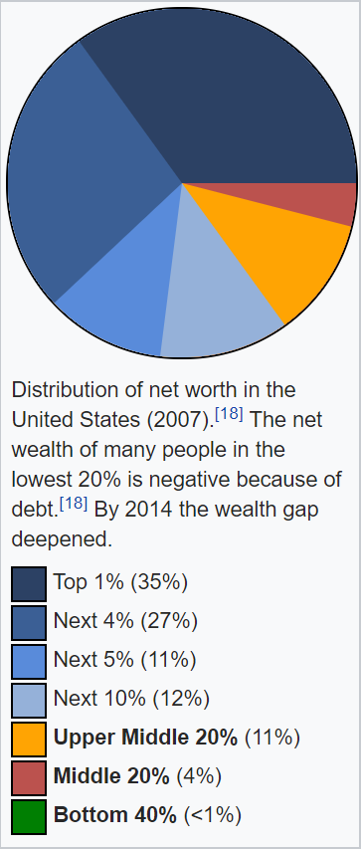
How does uneven distribution of wealth affect segregation?
Every person has wealth based on the right graph
N number of regions
Each region has a price to move based on its population’s average wealth and a percentage of red to blue colors
Each person wants to move to the most expensive region they can afford that meets their color preferences
If their current and affordable more expensive regions do not meet color preferences then a person will move to the most expensive cheaper region that meets their preferences
People can only move to a region if there’s empty space
https://en.wikipedia.org/wiki/Wealth_inequality_in_the_United_States
Notes:
with $1,000,000 total dollars and there being 2 Top 1% turtles, then each Top 1% turtle will have $175,000, and if there’s 82 Bottom 40% turtles then each Bottom 40% will have $121
every tick the price of all the regions is calculated one time
the color % of the region they moved to and left from is updated

Slide 6
Hypothesis
Segregation will emerge based on both color and wealth assigned to the agent population
As a region is filled with like people with high wealth, all other high wealth people of a similar color will move there, thus pushing out anyone of not similar color
As the number of regions increased, the level of segregation would also increase
If there are available regions everyone, even the poorest of people will have an area to move to

Slide 7
Results
Confirm our hypothesis
As the number of regions increases, the more homogeneous each region becomes as there are more regions than the possible combinations of color and wealth brackets
As the slider for red-to-blue distribution leaned more towards one color, moving from approximately 25% to 75%, we observed more integration of wealth brackets and color in all the regions

Slide 8
Conclusions
A desire to live in a location for some intrinsic value of that location can cause segregation or even gentrification
Our first simulation shows this where the intrinsic value of the desirable zone is the amount of similar agents living in it
Our second simulation shows this where the intrinsic value of the region is the cost of living inside of that region

